Slide 1
CIS8695 Managing Big Data Analytics
Nasim Mousavi
Assistant Professor
J. Mack Robinson College of Business
Georgia State University
nmousavi@gsu.edu

Slide 2
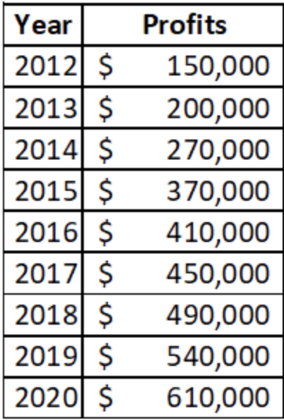
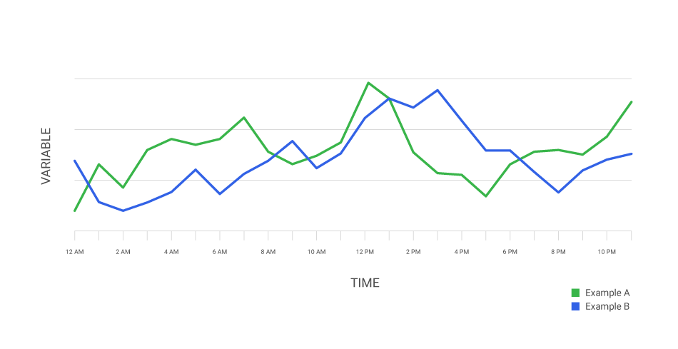
Time Series Data
Until now we have dealt with classifying and predicting data where time is not a factor
In the sense that it is not treated differently from other variables, and where the sequence of measurements over time does not matter.
These are typically called cross-sectional data.
We want to learn how to deal with a different type of data: time series

Slide 3
Time Series Analysis
Time series forecasting is performed in nearly every organization that works with quantifiable data
Retail stores use it to forecast sales
Energy companies use it to forecast reserves, production, demand, and prices
Educational institutions use it to forecast enrollment
Governments use it to forecast tax receipts and spending
…

Slide 4
Time Series Analysis
The Main Idea is forecasting future values of a time series
Components of time series:
Level
Average value of the series (intercept in the regression model)
Trend
The change in the series from one period to the next (coefficient in the regression model)
Noise
A random variation that results from measurement error or other causes not accounted for (error in the regression model)
Seasonality
A short-term cyclical behavior of the series

Slide 5
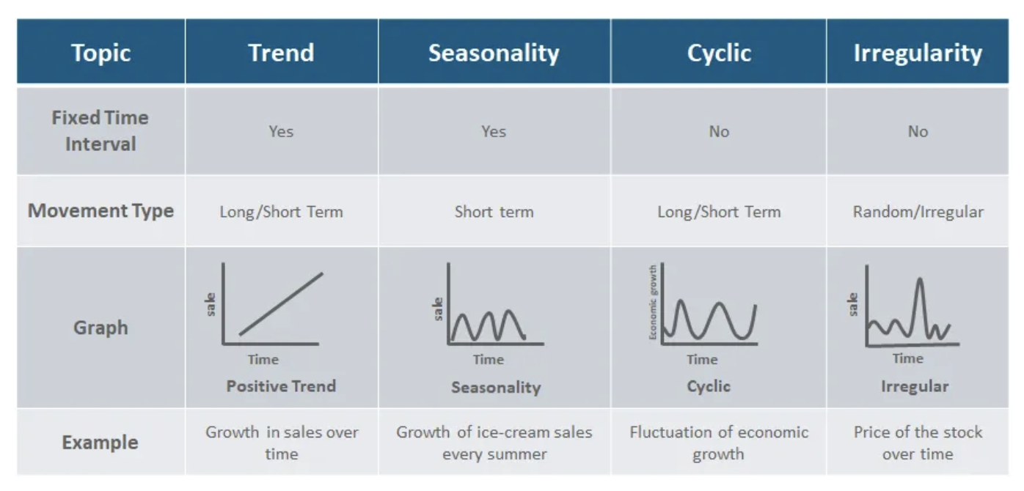
Time Series Analysis

Slide 6
Time Series Analysis: Regression

Slide 7
Main Ideas
Linear regression is a popular forecasting model to capture linear trend and seasonality
Modify & use for non-linear trends
Exponential
Polynomial

Slide 8
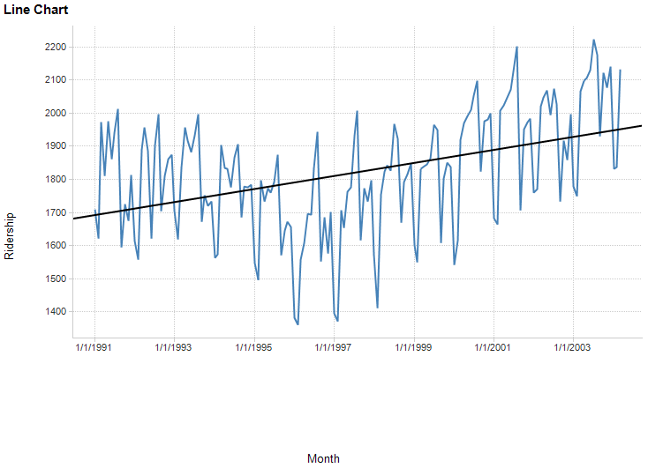
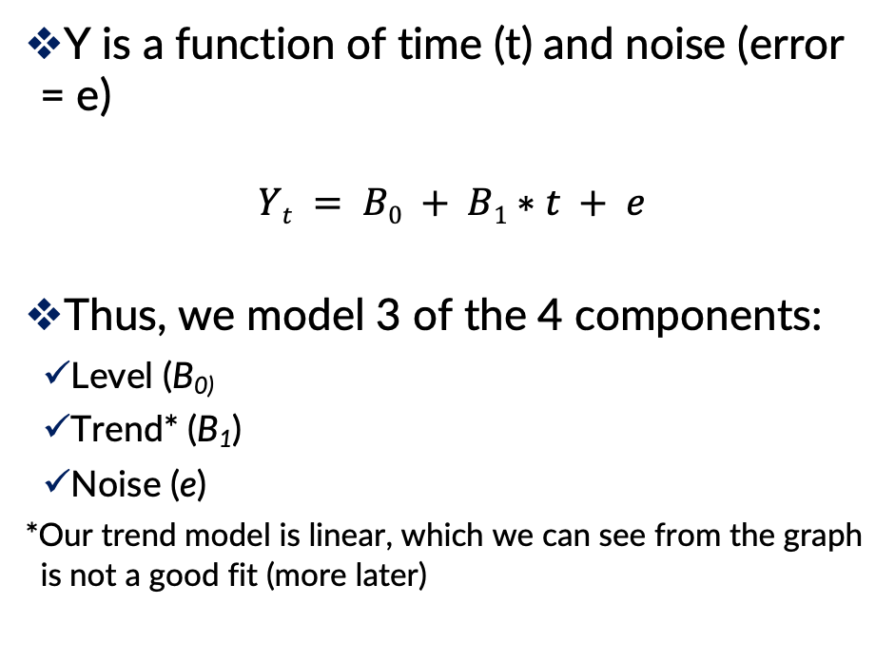
Regression Model
Y is a function of time (t) and noise (error = e)
$$Yt = B0 + B1∗t + e$$
Thus, we model 3 of the 4 components:
Level (B₀₎
Trend* (B₁)
Noise (e)
*Our trend model is linear, which we can see from the graph is not a good fit (more later)

Slide 9
Partitioning Data and Performance Evaluation
Can we use the random partition that we used before?
Random partition would create two time series with missing values and the models cannot handle them
The series is trimmed into two periods; the earlier period is set as the training data and the later period as the validation data
Evaluation:
MAE
RMSE

Slide 10
Another Difference between Cross-Sectional & Time-Series
After validating the model performance using the validation set, you need to run the model on the complete dataset (training + validation)
Then evaluating its performance once more with more data
Why?
The validation set, which is the most recent period, usually contains the most valuable information in terms of being the closest in time to the forecast period
With more data (the complete time series compared to only the training set), some models can be estimated more accurately

Slide 11
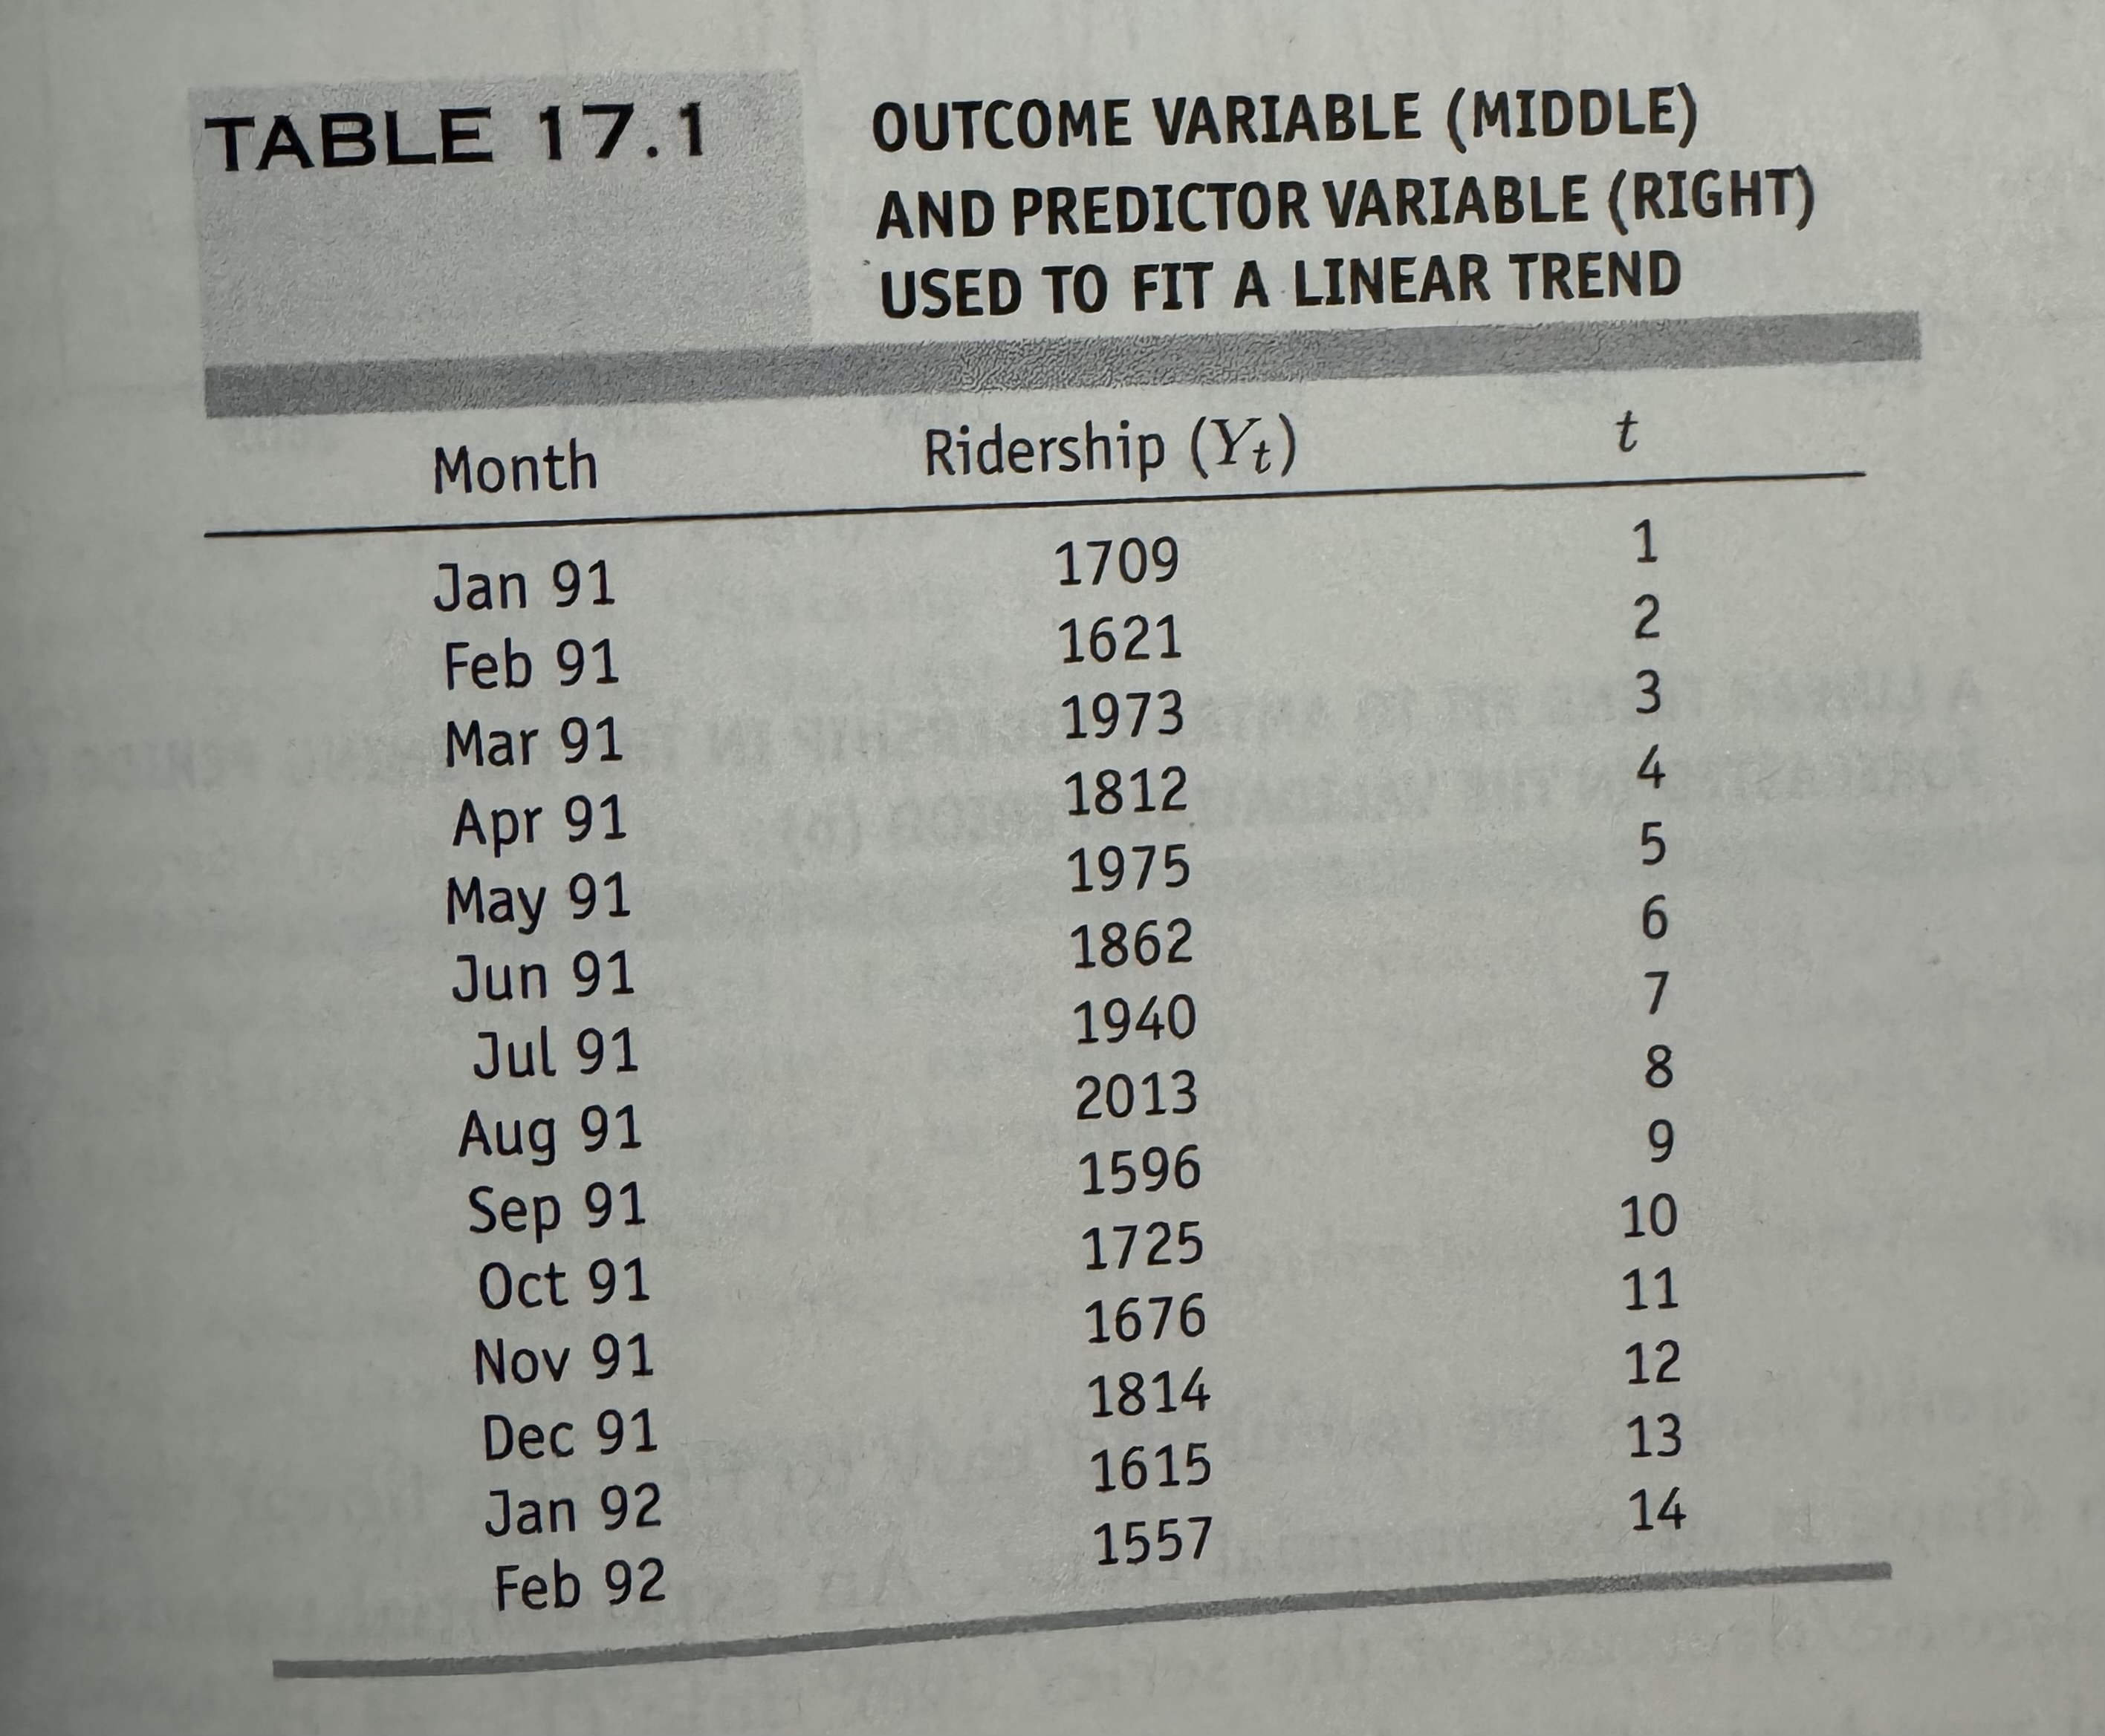
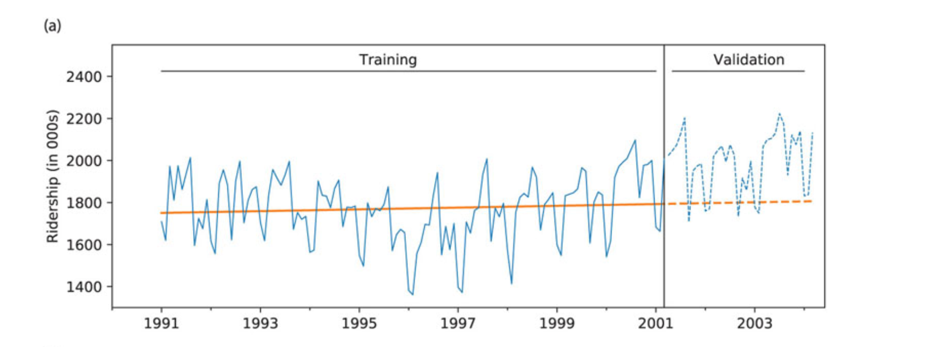
Regression Model

Slide 12
Non-Linear Trend
Several alternative trend shapes are useful and easy to fit via a linear regression model
Exponential Trend
Polynomial Trend

Slide 13
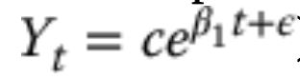
Exponential Trend
Appropriate model when increase/decrease in series over time is multiplicative
e.g., t₁ is x% more than t₀, t₂ is x% more than t₁…
To fit an exponential trend, simply replace the outcome variable Y with log Y (where log is the natural logarithm), and fit a linear regression
log(Y_{i}) = B₀ + B₁t + e

Slide 14
Exponential Trend
Note that performance measures in standard linear regression are not in original units
Model forecasts will be in the form log(Y)
Return to original units by taking exponent of model forecasts

Slide 15
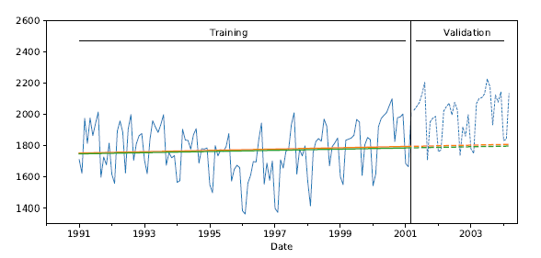
Exponential Trend
Exponential trend (green) very similar to linear trend (orange) - neither copes well with initial period of decline followed by growth period

Slide 16
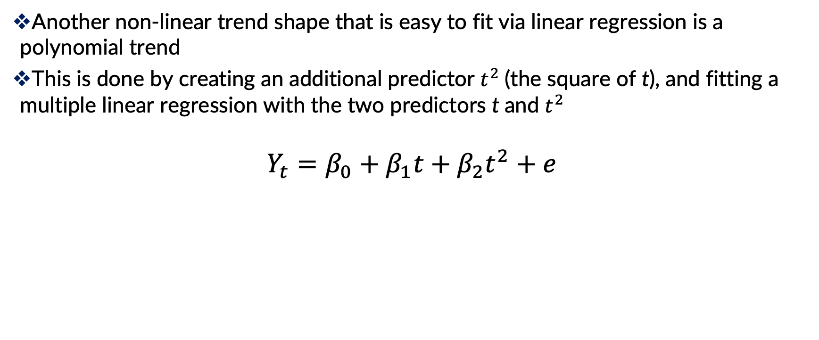
Polynomial Trend
Another non-linear trend shape that is easy to fit via linear regression is a polynomial trend
This is done by creating an additional predictor $t^{2}$(the square of t), and fitting a multiple linear regression with the two predictors t and $t^{2}$
$$Y_{t}=β_{0}+β_{1}t+β_{2}t^{2}+e$$

Slide 17
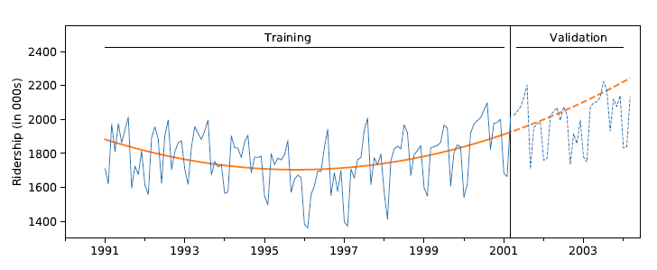
Polynomial Trend
Better job capturing the trend, though it over forecasts in validation period.
Next: we’ll try capturing seasonality.

Slide 18
Handling Seasonality
A seasonal pattern in a time series means that periods in some seasons have consistently higher or lower values than those that fall in other seasons
Examples: day-of-week patterns, monthly patterns, and quarterly patterns
Handle in regression by adding a new categorical variable for each season

Slide 19
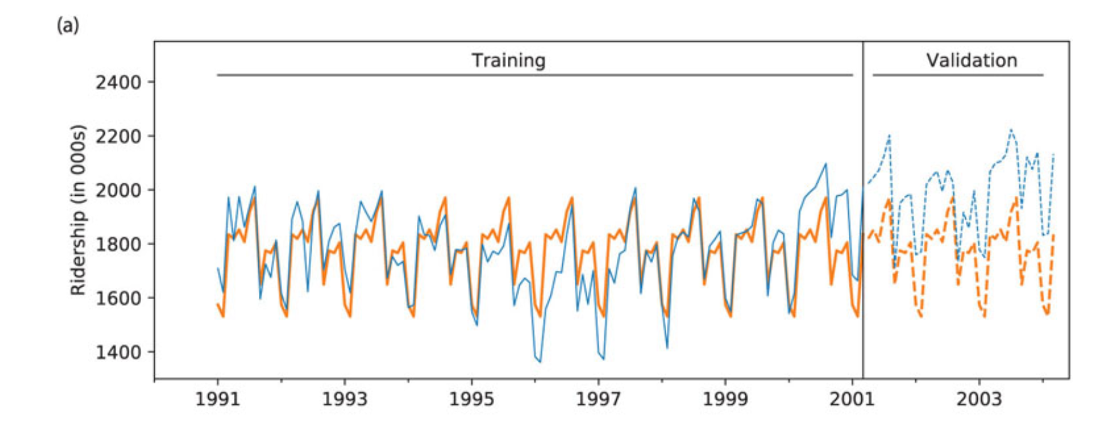
Model with Trend and Seasonality
Incorporates quadratic trend and seasonality
13 predictors:
11 monthly dummies

Slide 20
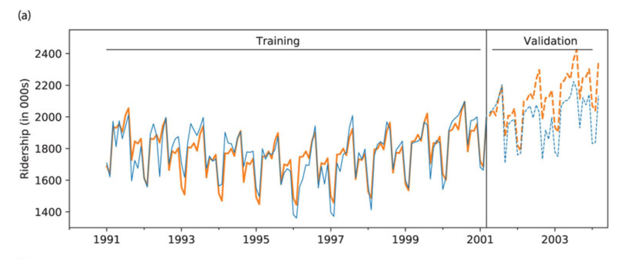
Model with Trend and Seasonality
Incorporates quadratic trend and seasonality
13 predictors:
11 monthly dummies
t
t²

Slide 21
Auto-Correlation
Linear regression can account for patterns such as trend and seasonality.
However, it cannot account for dependence between values in different periods (autocorrelation)
A high value tends to be followed by high values

Slide 22
Auto-Correlation
Correlation between values of a time series in neighboring periods is called autocorrelation
To compute autocorrelation, we compute the correlation between the series and a lagged version of the series.
A lagged series is a “copy” of the original series which is moved forward one or more time periods.
A lagged series with lag-1 is the original series moved forward one time period

Slide 23
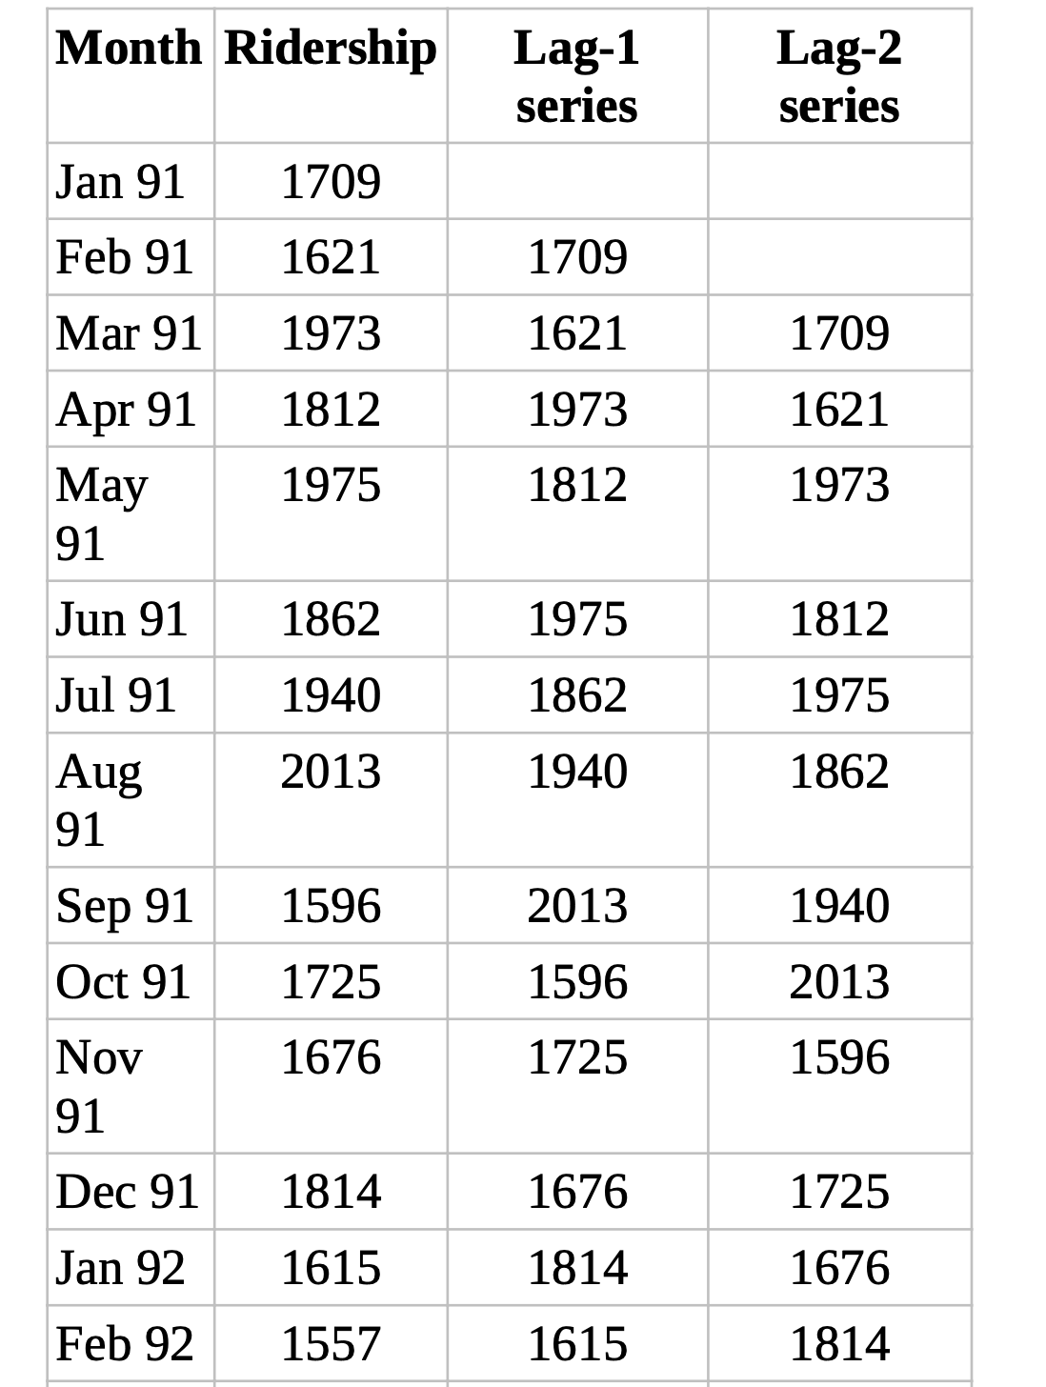
Auto-Correlation
To compute the lag-1 autocorrelation, we compute the correlation between the original series and the lag-1 series

Slide 24
Auto-Correlation
Strong autocorrelation at a lag K > 1 and its multiples (2k, 3k, ...) typically reflects a cyclical pattern.
For example, strong positive lag-12 autocorrelation in monthly data will reflect an annual seasonality (where values during a given month each year are positively correlated).
Positive lag-1 autocorrelation (called “stickiness’’) describes a series where consecutive values move generally in the same direction.
In the presence of a strong linear trend, we would expect to see a strong and positive lag-1 autocorrelation.
Negative lag-1 autocorrelation reflects swings in the series, where high values are immediately followed by low values and vice versa.

Slide 25
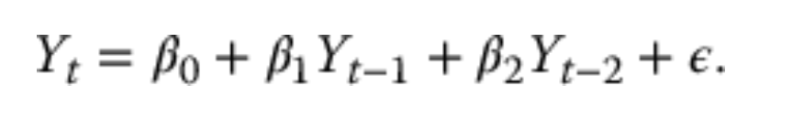
Auto-Correlation
Examining the autocorrelation of a series can help us to detect seasonality patterns.
Autoregressive (AR) models, or the more general models called ARIMA (Autoregressive Integrated Moving Average), can handle auto-correlation.
AR models are similar to linear regression models, except that the predictors are the past values of the series.
For example, an autoregressive model of order 2, denoted AR(2), can be written as:

Slide 26
Time Series Analysis: Smoothing

Slide 27
Simple Smoothing Methods
A second class of time series models
Regression methods assume underlying unchanging structure (linear, exponential, polynomial)
Smoothing derives forecasts based directly on the data alone (e.g. averaging), with no mathematical structural assumptions
These methods “smooth” out the noise in a series to uncover the patterns
Smoothing is done by averaging the series over multiple periods

Slide 28

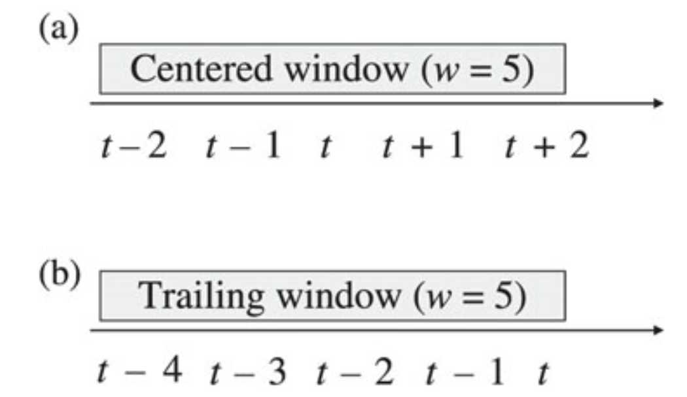
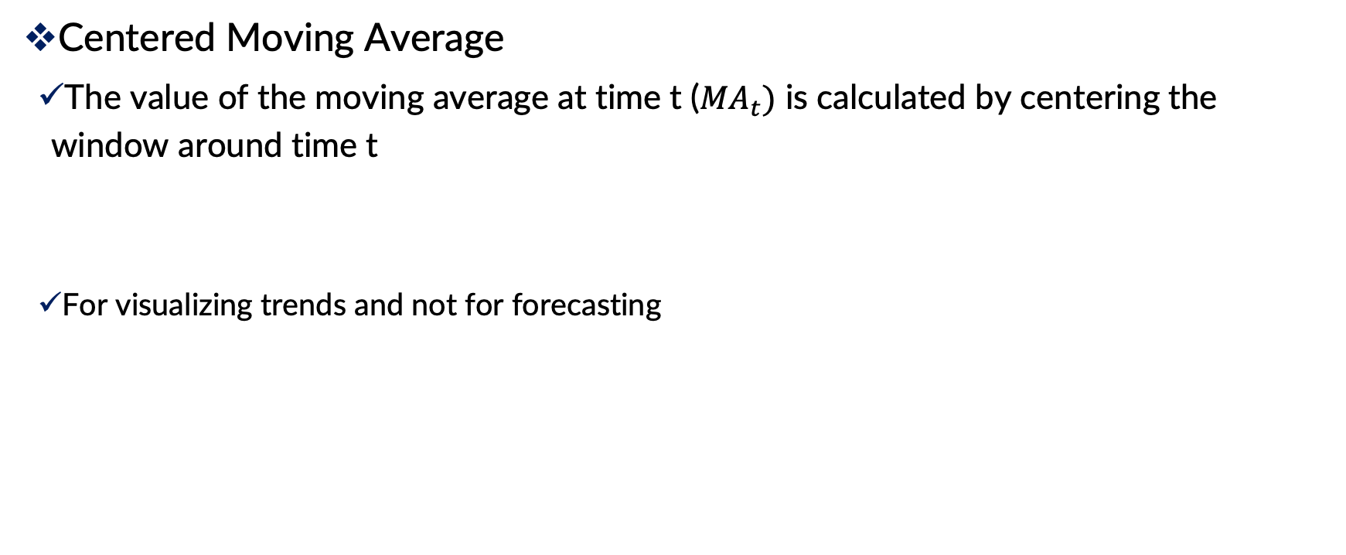
Simple Smoothing Methods: Moving Average
Centered Moving Average
The value of the moving average at time t (${MA}_{t})$ is calculated by centering the window around time t
For visualizing trends and not for forecasting

Slide 29
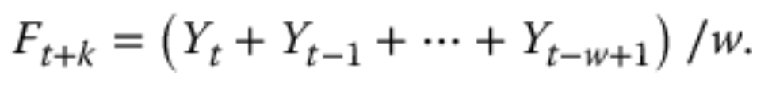
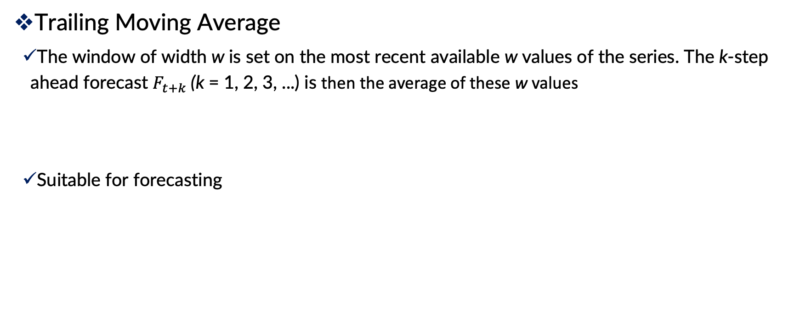
Simple Smoothing Methods: Moving Average
Trailing Moving Average
The window of width w is set on the most recent available w values of the series. The k-step ahead forecast $F_{t+k}$(k = 1, 2, 3, ...) is then the average of these w values
Suitable for forecasting

Slide 30
Moving Average: Choosing Window Width
Like other methods such as k-nearest neighbors, w should be chosen based on the balance between under-smoothing and over-smoothing
Exploring different values of w to find the optimal one

Slide 31

Simple Smoothing: Exponential Smoothing
A popular forecasting method in business is exponential smoothing.
Due to its flexibility, ease of automation, cheap computation, and good performance.
Similar to forecasting with a moving average, except that instead of taking a simple average over the w most recent values, we take a weighted average of all past values, such that:
Give more weight to recent information, yet not to completely ignore older information.
α is a constant between 0 and 1 called the smoothing parameter

Slide 32
Simple Smoothing: Exponential Smoothing
The smoothing parameter α, which is set by the user, determines the rate of learning.
A value close to 1 indicates fast learning (that is, only the most recent values have influence on forecasts)
whereas a value close to 0 indicates slow learning (past values have a large influence on forecasts).
Hence, the choice of α depends on the required amount of smoothing, and on how relevant the history is for generating forecasts.
Default values that have been shown to work well are around 0.1–0.2.
Some trial and error can also help in the choice of α
Based on prediction performance (RMSE)

Slide 33
Smoothing: Shortcomings
Simple smoothing methods are useful only for series that lack trend and seasonality
Use regression model to de-trend and de-seasonalize & then use simple smoothing methods
More sophisticated smoothing methods

